Slide 1


City of Sunset Valley Capital Improvements
Public Meeting
April 12, 2023
Presentation by:
Freeland Turk Engineering Group

Slide 2
Presentation Summary
Project locations and potential impacts to residents.
What this work will look like.
Approximate timeline – more detail as project progresses.
City Point of Contact
Questions

Slide 3
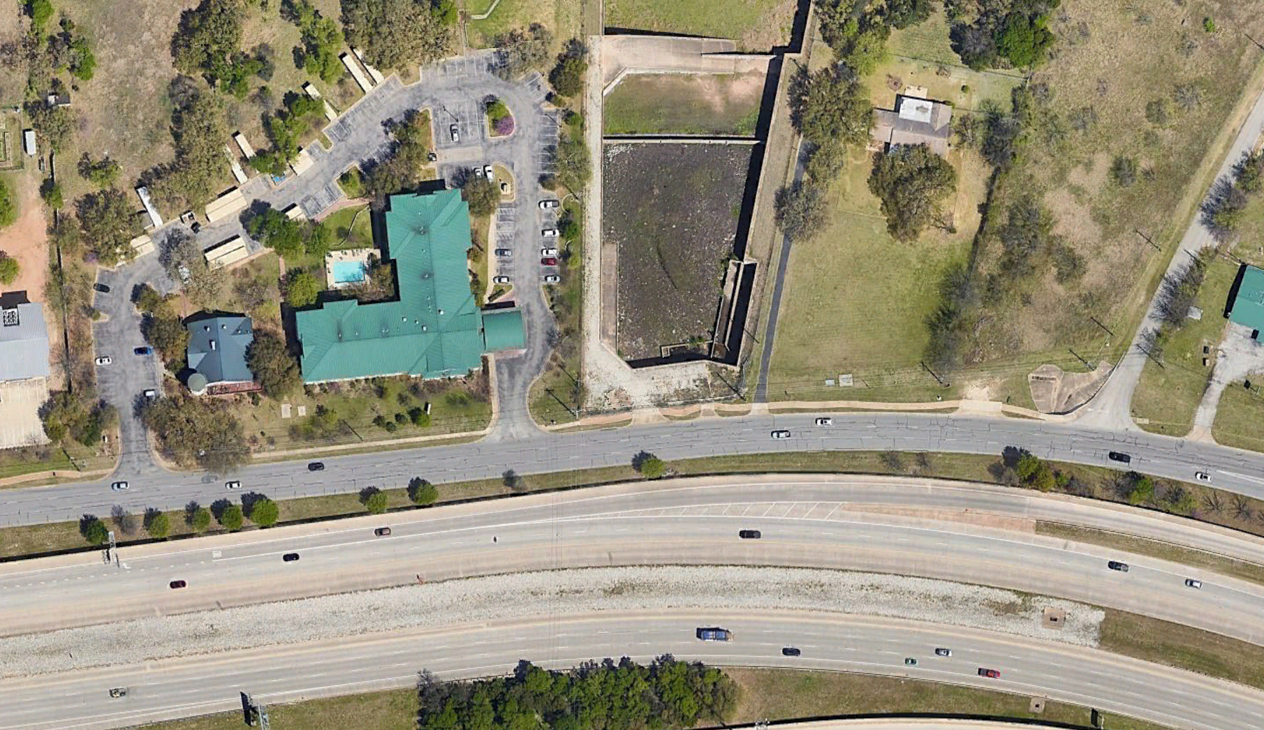
Project Location
Sanitary Sewer Replacement Along Hwy 290 in front of Holiday Inn and TxDOT Pond area

Slide 4
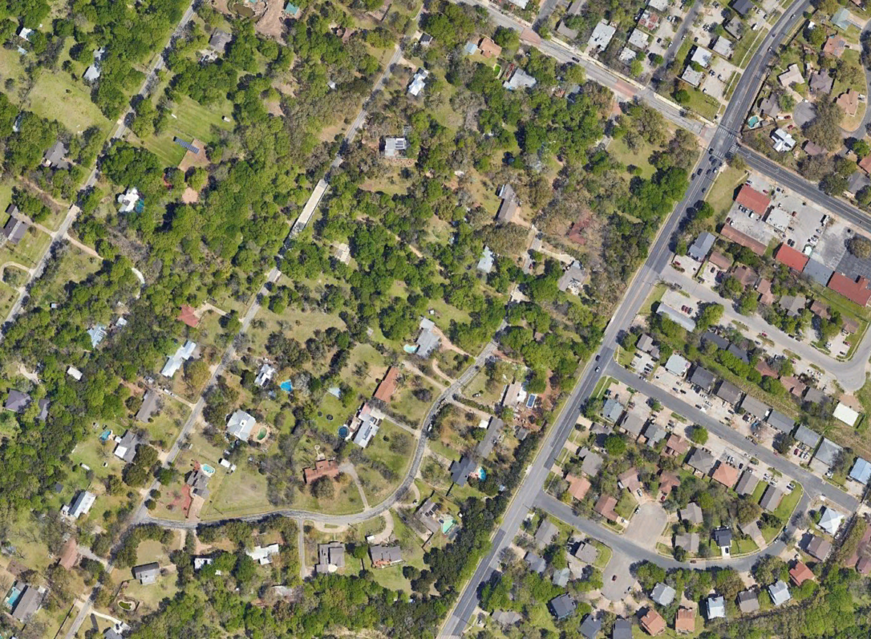
Project Location
Water Line Replacement on Sunset Trail and parts of Lone Oak Trail
One Lane Traffic/Detours

Slide 5
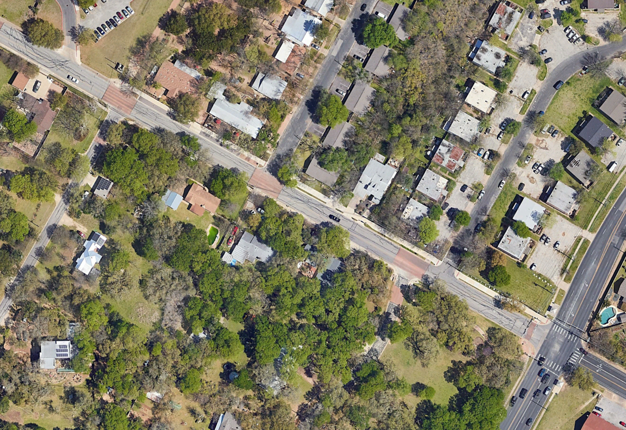
Project Location
Jones Road
Drainage Improvements
  Inlet Replacement and Swale
  AISD Meter Conversion

Slide 6
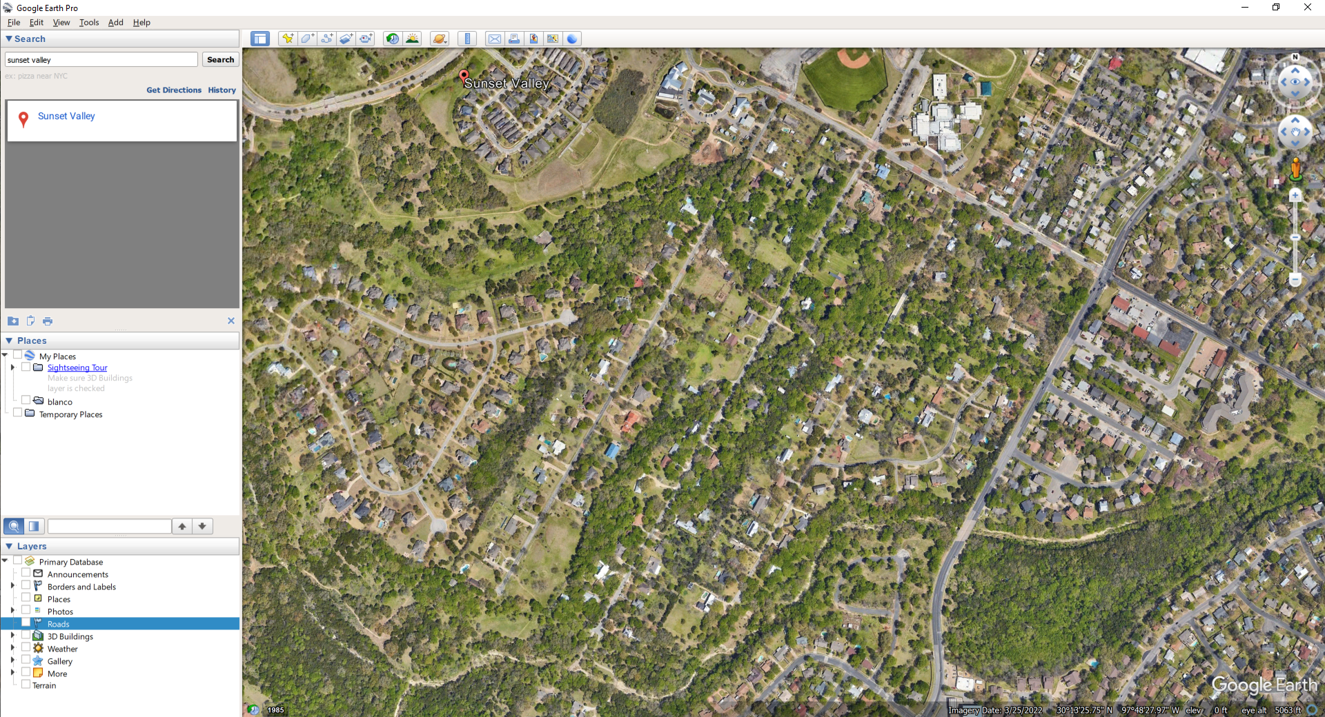
Project Location
Water Line Replacement parts of Lone Oak Trail
Turnaround at end of Lone Oak Trail

Slide 7
Project Location
2” Asphalt Mill and Overlay
Active Traffic Control during Mill and Overlay Operations

Slide 8
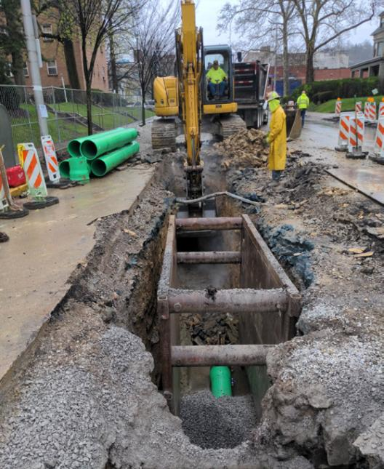
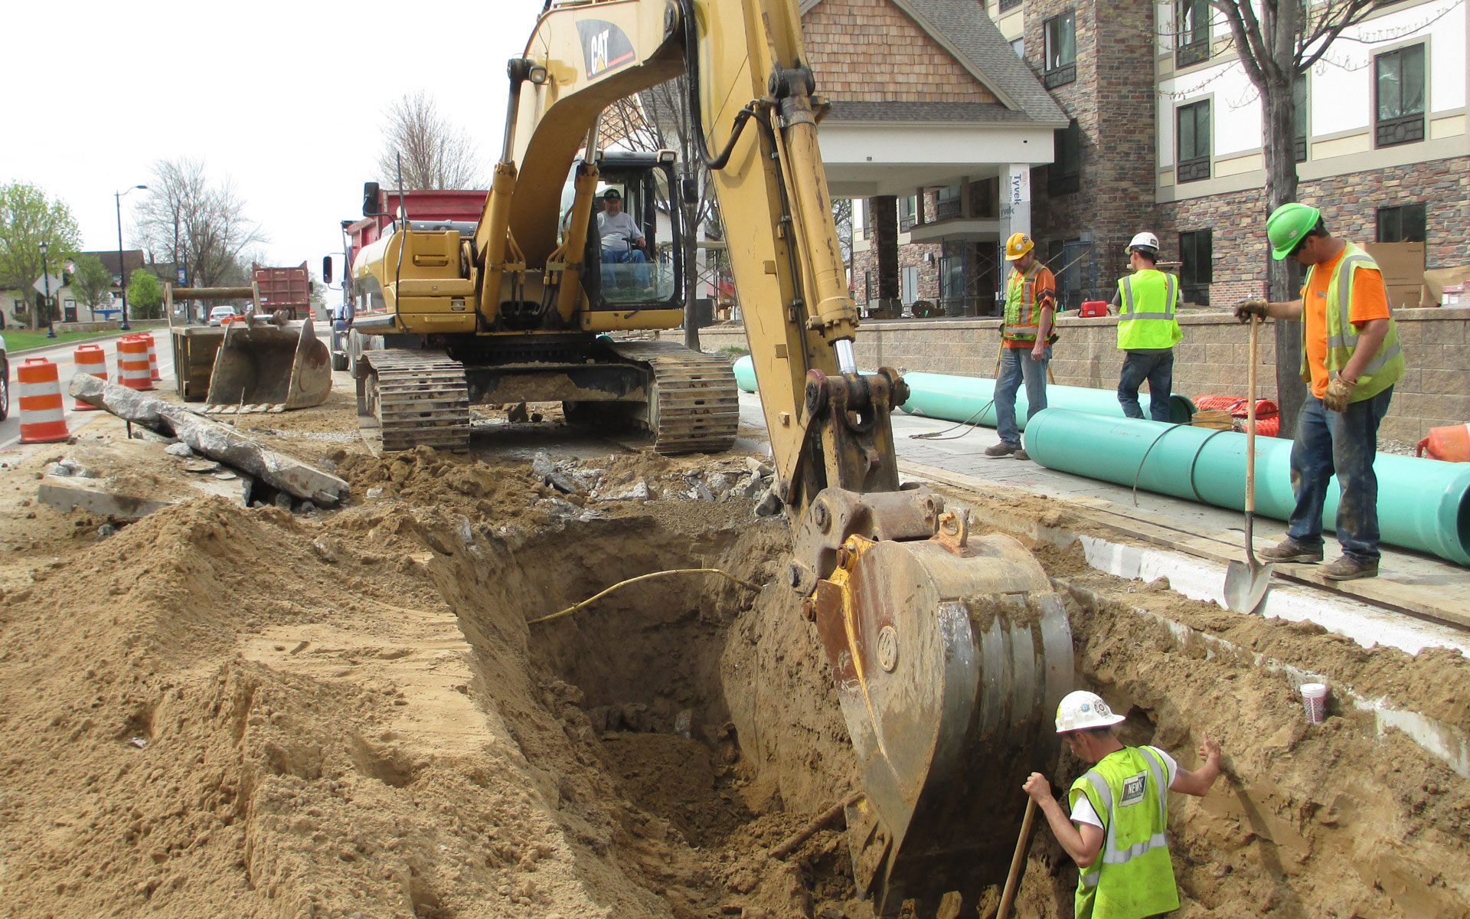
Construction is Coming – What to Expect
HWY 290 Sewer Replacement

Slide 9
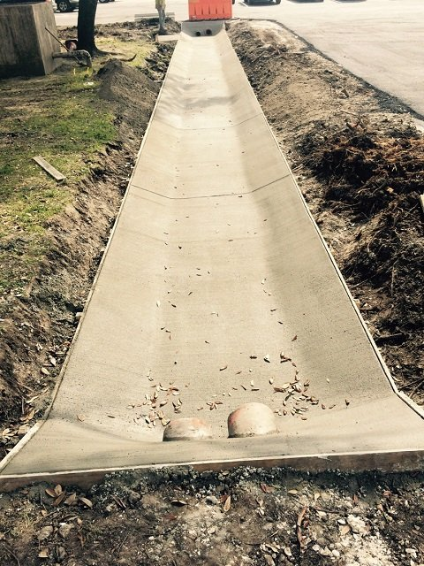
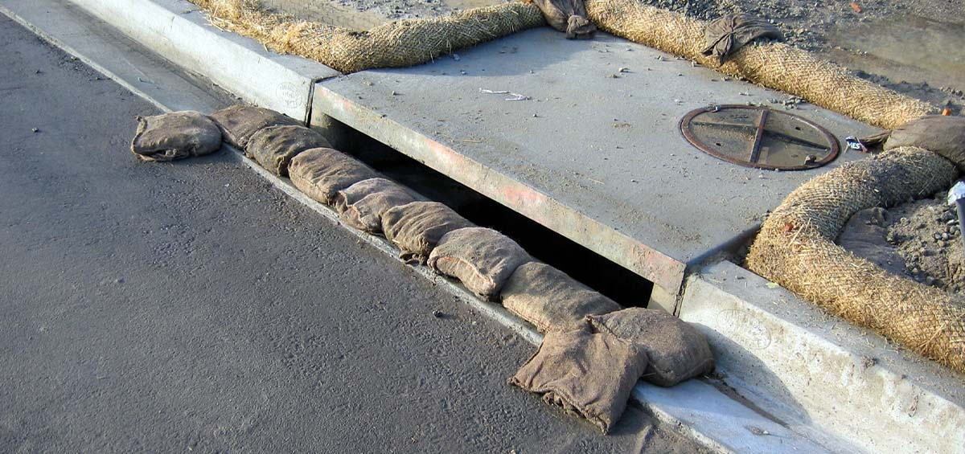
Construction is Coming – What to Expect
Jones Road Drainage

Slide 10
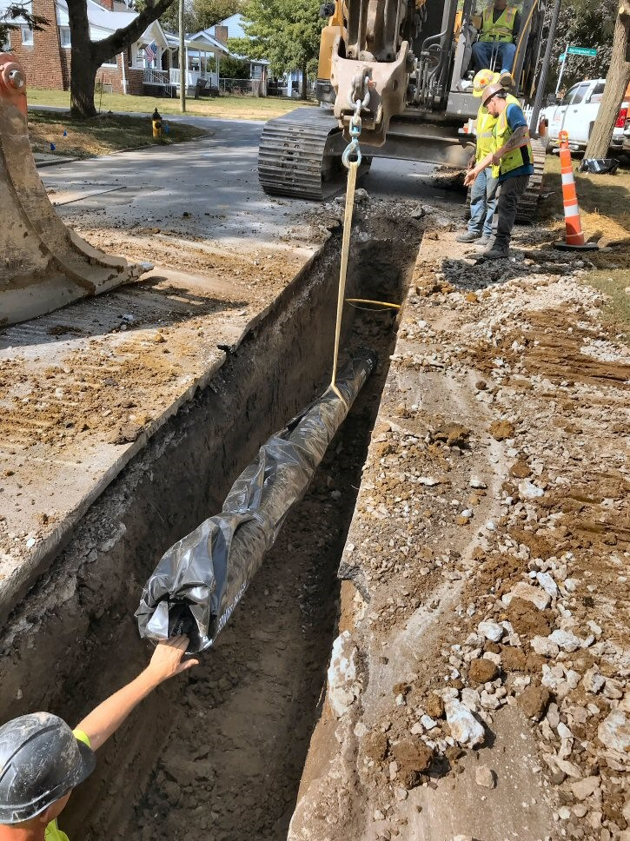
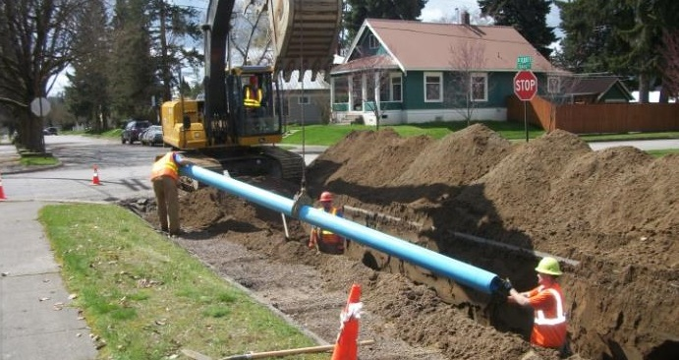
Construction is Coming – What to Expect
Sunset Trail and Lone Oak Trail Water Line Construction

Slide 11
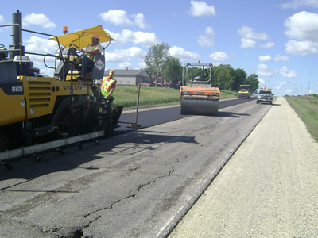
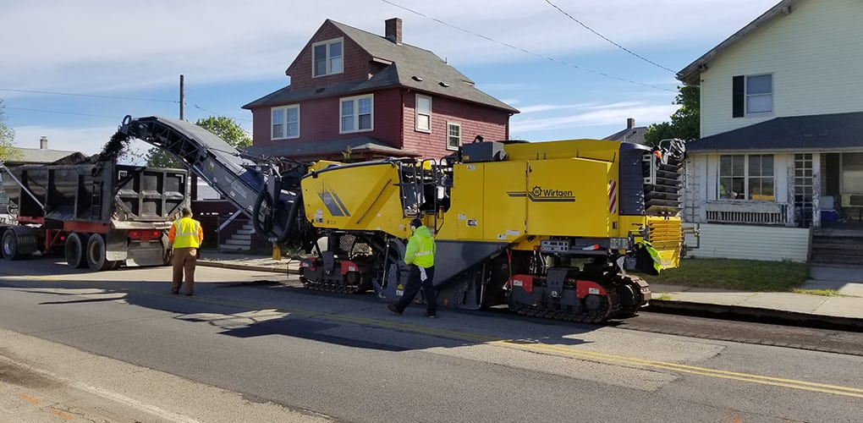
Construction is Coming – What to Expect
Sunset Trail and Lone Oak Trail Mill and Overlay

Slide 12
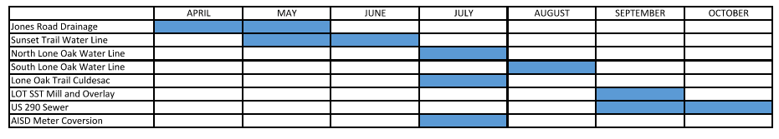
Questions?
Contact Information
City Contact – Dakota Burns - Public Works Superintendent – 512-891-9103
Emergency Situations– Call 911

